Slide 1


Slide 2
INDEX
Your index of contents
TEAM NAME - SAGANISTS
TEAM MEMBERS
Ghurujayaraj – 2025 – SRM KTR
Prajin Chopra – 2025 – SRM KTR
Rasesh Gautam – 2025 – SRM KTR

Slide 3
SO, HOW IS OUR SOLUTION DIFFERENT?
There are more than 2.69 billion gamers in the world.
According to the ESA, 67 percent of all American adults, those 18 years and up, play games, while 76 percent of kids, those under 18 years old, are gamers. Keeping in mind , the growing potential of gaming experience integrated with education , we have come up with a quiz based game
The game which we aim to develop is a fully user interactive application.
It provides its users with various gameplay options along with the ability to unlock various other elements in the game.
The hook which the game provides is its racing simulation. The faster a user answers the question , the faster his/her vehicle travels in order to complete the race.

Slide 4


YOUR SELECTED PROBLEM STATEMENT
Give us an overview of your solution:
The game focuses to develop a competitive spirit among the players and also at the same time provide some insights about space like why knowledge about space is important, how it affects everyone on the Earth and also some interesting crunchy space facts.
The game would have a streak system in which as the user correctly answers the questions consecutively, he would score more points compared to his/ her previous questions and if the user breaks his/her streak then the user would continue from the same place but streak points would start from the start again and the previous points would be added with new points.

Slide 5



The user would get 3 chances to continue the game if he/her answers wrong and after that user's game would end.
The game round would go on for 3 minutes and after that, the person with the highest points on the leaderboard wins.
Each user who participates in the game would get some in-game coins according to his/ her final position in the game round and later could use those coins for buying in-game stuff like skins for rockets, up-gradation of the various parts of the rocket for its better performance during the game, etc.
These in-game purchases of stuff related to rockets would also help users understand a little bit about the functioning of the rockets and what are the various parts used in rockets and could also act as a gateway that could lead players to develop an interest in rockets and things related to them.

Slide 6
Questions would be:
1) Our sun is made up of what?
2) What is the age of sun?
3) During fusion, hydrogen converted into?
4) What is the color of sun?
5) what is the distance between earth and sun?
6) How much mass the sun contains?
7) The sun has how many layers?
8) What happens in the core of the sun?
9) Sun located in which place in our galaxy?
10) how old is the sun?
11) The nearest star of the solar system?
12) Why the fusion occurs in core of the sun?
13) What is the core temperature of the sun?
Why the sun has a light source?
15) What is the origin of the sun?

Slide 7
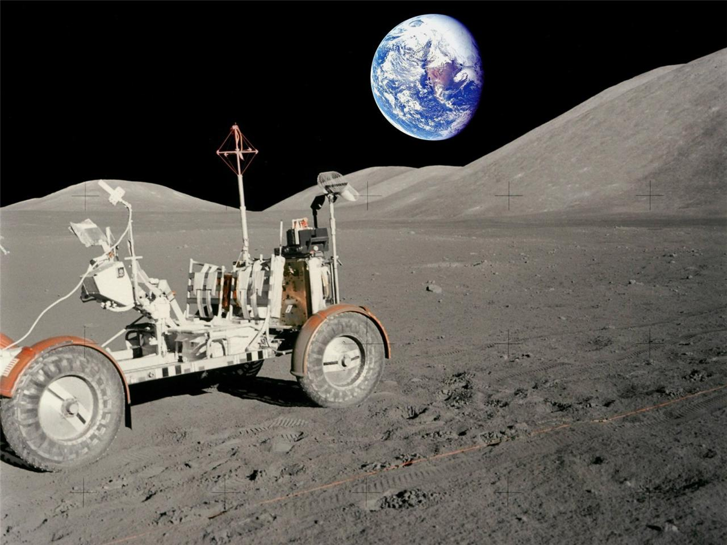
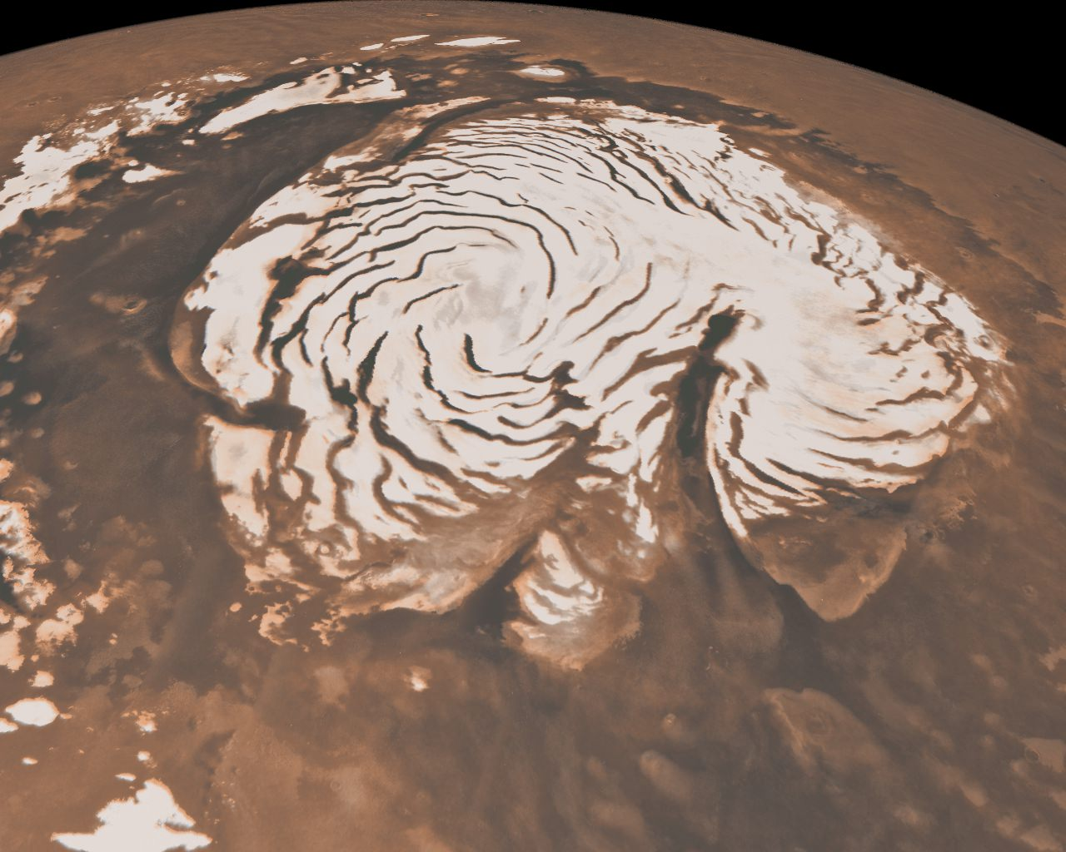

Future development:
We are planning to create a universe in our game in the future and expand it, where we would have various maps for different planets, different lunar vehicles to explore the planets, we would have an option of building nations on different planets and later on various planets could competing with each other.
We also want to create more and better simulations in the game for a better in-game experience for players.
We could also create various events happening in the game during different periods and incentivized players for them like snow skating on the north and south poles of Mars, Hill climbing, Giant attack in Olympus of Mars, etc.
As the player progresses in the game and increases his level, he could explore more things in space like various mysteries there, new dimensions of the world, or parallel universes.

Slide 8
SUBMISSION LINKS
GITHUB LINK –
https://github.com/Ghurujayaraj05/NASA-Space-App---team-Saganist

Slide 9
ANYTHING ELSE ?
Any additional information that you would want us to know

